Slide 1
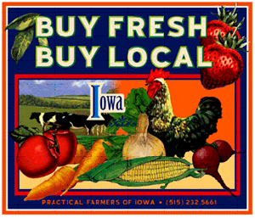
Buy Fresh, Buy Local
By Sam Lynch

Slide 2
Top 3 Reasons to Buy Fresh and Local
It increases market access, sales volume, and net income of local producers.
It reduces carbon emissions created by transporting food over long distances
Local food is fresh so it tastes fresher and better

Slide 3
How to Get Started
Visit your local farmers market and get to know the vendors.
Decide what is local to you
Start a garden, it doesn’t get more local than your own backyard!
For interesting reading and inspiration to buying fresh and local, read Animal, Vegetable, Miracle by Barbara Kingsolver

